Slide 1

HTTPS and the Lock Icon
Web security

Slide 2
Goals for this lecture
Brief overview of HTTPS:
  How the SSL/TLS protocol works (very briefly)
  How to use HTTPS
Integrating HTTPS into the browser
  Lots of user interface problems to watch for

Slide 3
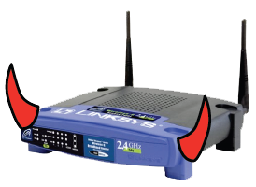
Threat Model: Network Attacker
Network Attacker:
Controls network infrastructure: Routers, DNS
Eavesdrops, injects, blocks, and modifies packets
Examples:
Wireless network at Internet Café
Internet access at hotels (untrusted ISP)

Slide 4
TLS overview: (1) DH key exchange
Anonymous key exchange secure against eavesdropping:
The Diffie-Hellman protocol in a group G = {1, g, g², g³, …, g^{q-1}}
Browser Alice
Server Bob
a ⟵ {1,…,q}
A = gª ∈ G
b ⟵ {1,…,q}
B = g^{b} ∈ G
PMS = Bª
PMS = A^{b}
PreMasterSecret = g^{ab} = (g^{b})ª = Bª = (gª)^{b} = A^{b}
Notes:
eavesdropper learns nothing about PMS.

Slide 5
(2) Digital signatures
Goal: bind document to author
  Problem: attacker can copy Alice’s sig from one doc to another
Main idea: make signature depend on contents of document
Def: a signature scheme is a tuple of three algorithms:
Gen() ⇾ (pk, sk)
Sign(sk, msg) ⇾ sig
Verify(pk, msg, sig) ⇾ ‘accept’ or ‘reject’
sign msg using sk
verify (msg,sig) using pk

Slide 6
(2) Digital signatures
Goal: bind document to author
  Problem: attacker can copy Alice’s sig from one doc to another
Main idea: make signature depend on contents of document
Security (informal): adversary who sees signatures on many messages of its choice, cannot forge a signature on a new message.
Def: a signature scheme is a tuple of three algorithms:
Gen() ⇾ (pk, sk)
Sign(sk, msg) ⇾ sig
Verify(pk, msg, sig) ⇾ ‘accept’ or ‘reject’
sign msg using sk
verify (msg,sig) using pk

Slide 7
Signature schemes used in the real world
RSA signature scheme:
Fast to verify, but signatures are long
Often used in certificates
ECDSA, Schnorr, BLS signature schemes:
Faster to generate signature and more compact than RSA
Used everywhere, other than web certificates

Slide 8

(3) Certificates
How does Alice (browser) obtain pk_{Bob} ?
Browser
Alice
CA
Server Bob
choose
(sk,pk)
pk and
proof “I am Bob”
check
proof
pk_{CA}
pk_{CA}
sk_{CA}
issue Cert with SK_{CA} :
Verify
cert
Bob’s
key is pk
Bob’s
key is pk
Bob uses Cert for an extended period (e.g. one year)

Slide 9

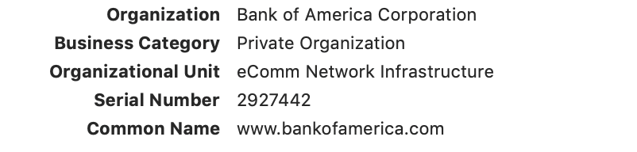
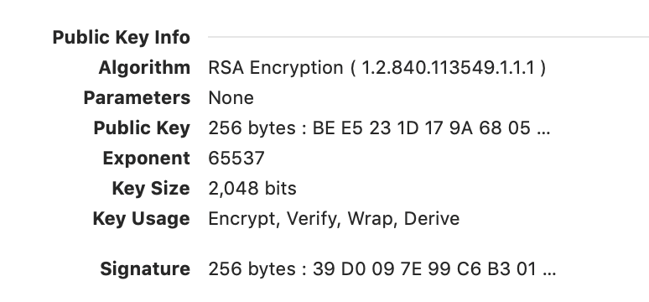
22
Sample certificate:
(by CA)

Slide 10
Certificates on the web
Subject’s CommonName can be:
An explicit name, e.g. cs.stanford.edu , or
A wildcard cert, e.g. *.stanford.edu or cs*.stanford.edu
matching rules:
“*” must occur in leftmost component, does not match “.”
example: *.a.com matches x.a.com but not y.x.a.com
(as in RFC 2818: “HTTPS over TLS”)

Slide 11
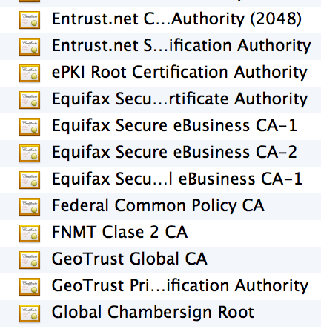
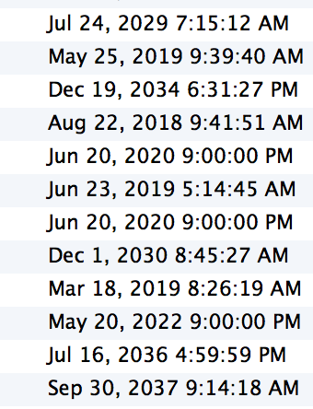
Certificate Authorities
⋮
Browsers accept
certificates from a
large number of CAs
Top level CAs ≈ 60
Intermediate CAs ≈ 1200
⋮

Slide 12
(4) TLS 1.3 session setup (simplified)
Diffie-Hellman key exchange
Client
ClientHello: nonce_{C} , KeyShare
Server
ServerHello: nonce_{S} , KeyShare, Enc[cert_{S},…]
CertVerify: Enc[Sig_{S}(data)] , Finished
secret
key
authenticates server
cert_{S}
Finished
session-keys ← HKDF( DHkey, nonce_{C} , nonce_{S} )
Encrypted ApplicationData
Encrypted ApplicationData
Most common: server authentication only
Notes:
Note encrypted server certificate.

Slide 13
(3) TLS 1.3 session setup: optimization (and caution)
Client
ClientHello: nonce_{C} , KeyShare
, Enc[0-RTT data]
Server
ServerHello: nonce_{S} , KeyShare, Enc[cert_{S},…]
CertVerify: Enc[Sig_{S}(data)] , Finished
secret
key
authenticates server
Data encrypted using a pre-shared key
Caution: 0-RTT data is vulnerable to replay
⇒ data should have no side effects
(i.e. GET but not POST)
cert_{S}
Finished
session-keys ← HKDF( DHkey, nonce_{C} , nonce_{S} )
Encrypted ApplicationData
Encrypted ApplicationData
Most common: server authentication only

Slide 14

Integrating TLS with HTTP: HTTPS
HTTP/2
(2015)
HTTP/3
(2022)
HTTP
QUIC
TLS
TLS
TCP
IP
IP
TCP handshake ⇒ TLS handshake
integrated handshake
(encrypting by default)

Slide 15
Integrating TLS with HTTP: HTTPS
web
server
A complication:
Virtual hosting: many sites hosted at same IP address
solution since TLS 1.1: SNI (2003)
client_hello_extension: server_name=cnn.com
… but SNI defeats privacy benefit of encrypted cert in TLS 1.3.
Solution: enc. client hello (ECH) [encrypted with pk in server DNS]
client-hello
server-cert ???
cert_{XYZ}
cert_{ABC}
Notes:
SNI: server name indication, encrypted client hello (Dec. 2020): encrypt the entire client hello data.
What about DNS query (also defeats privacy): not a problem if browser uses DoH (DNS over HTTPS)

Slide 16
Integrating TLS with HTTP: HTTPS
web
proxy
Two complications
Web proxies
solution: browser sends
CONNECT domain-name
before client-hello
Virtual hosting: many sites hosted at same IP address
solution in TLS 1.1: SNI (June 2003)
client_hello_extension: server_name=cnn.com
SNI defeats privacy benefit of encrypted cert in TLS 1.3.
Solution: enc. client hello (ECH) [encrypted with pk in server DNS]
web
server
corporate network
web
server
client-hello
server-cert ???
cert_{CNN}
cert_{ABC}
Notes:
SNI: server name indication, encrypted client hello (Dec. 2020): encrypt the entire client hello data.
What about DNS query (also defeats privacy): not a problem if browser uses DoH (DNS over HTTPS)

Slide 17
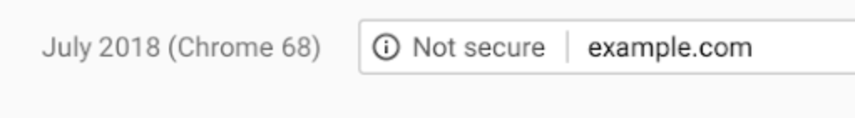

HTTPS for all web traffic?
Old excuse:
Crypto slows down web servers
  ⟹ no longer true (thanks to AES-NI)
Since July 2018: Chrome marks HTTP sites as insecure
Notes:
An example of a negative security indicator.

Slide 18
HTTPS in the Browser

Slide 19
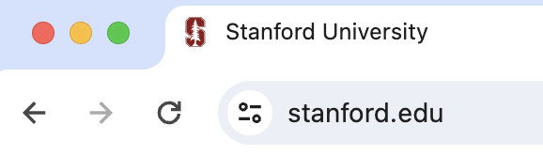
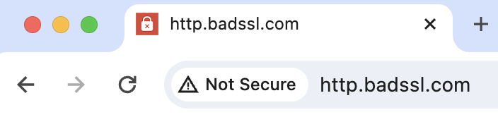
The TLS indicator
(HTTPS site)
(HTTP site)
vs.
Intended goal:
  Provide user with identity of page origin
  Indicate to user that page contents were not
  viewed or modified by a network attacker
Notes:
Network attacker: controls routers, DNS; can inject, delete, and modify packets
TLS indicator changes from a lock icon on May 2023.

Slide 20
When is the TLS icon displayed
All elements on the page fetched using HTTPS
For all elements:
    HTTPS cert issued by a CA trusted by browser
    HTTPS cert is valid (e.g. not expired)
    Domain in URL matches:
    CommonName or SubjectAlternativeName in cert

Slide 21
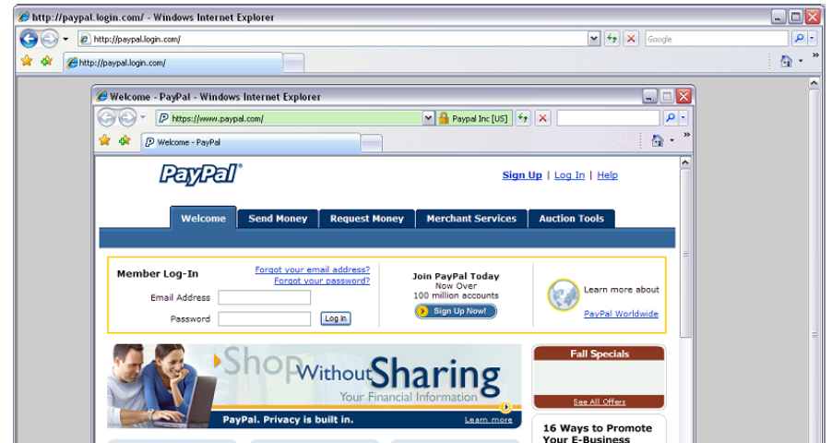
Positive security indicators are dangerous
The lock icon is a positive security indicator. Problem: picture-in-picture attacks.
Trained users are more likely to fall victim to this [JSTB’07]
Notes:
Both inner and outer windows are focused

Slide 22
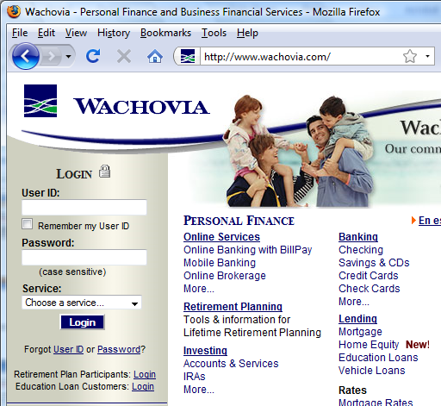
HTTPS and login pages: incorrect usage
Suppose user lands on HTTP login page.
    say, by typing HTTP URL
    into address bar
View source:
<form method="post"
action="https://onlineservices.wachovia.com/..."
(old site)
Notes:
User has no way to tell that his password is sent over HTTPS to site.
Also has no way to tell that page wasn’t modified enroute (e.g. change form action).
Note the confusing lock next to “LOGIN” that suggests this is HTTPS.

Slide 23
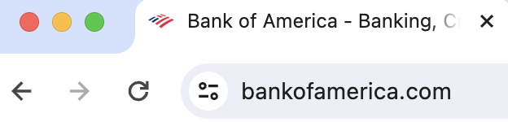
HTTPS and login pages: guidelines
General guideline:
    Response to http://login.site.com
    should be Location: https://login.site.com
(redirect)
Should be the response
to every HTTP request …

Slide 24
Problems with HTTPS and the Lock Icon

Slide 25
Problems with HTTPS and the Lock Icon
Upgrade from HTTP to HTTPS
Forged certs
Mixed content: HTTP and HTTPS on the same page
Does HTTPS hide web traffic?
  Problems: traffic analysis, compression attacks

Slide 26
1. HTTP ⇒ HTTPS upgrade
Suppose user does:
    connect to bank site over HTTP; bank redirects to HTTPS
SSL_strip attack: prevent the upgrade [Moxie’08]
<a href=https://…> ⟶ <a href=http://…>
Location: https://... ⟶ Location: http://... (redirect)
<form action=https://… > ⟶ <form action=http://…>
HTTP
SSL
attacker
web
server
Notes:
ssl_strip: prevents browser from upgrading, but does the SSL upgrade when communicating with the server. Server has no idea this is taking place.
Similar attack done on SMTP STARTTLES : http://arstechnica.com/tech-policy/2014/11/condemnation-mounts-against-isp-that-sabotaged-users-e-mail-encryption/

Slide 27


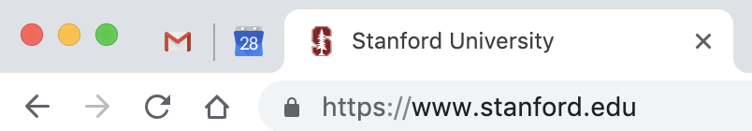
Tricks and Details
UI design flaw in old browsers: location of fav icon
⇒ fav icon no longer presented in address bar
Number of users who detected HTTP downgrade: 0
⟶

Slide 28
Defense: Strict Transport Security (HSTS)
Strict-Transport-Security: max-age=63072000; includeSubDomains
(ignored if not over HTTPS)
web
server
Header tells browser to always connect over HTTPS
Subsequent visits must be over HTTPS (self signed certs result in an error)
Browser refuses to connect over HTTP or if site presents an invalid cert
Requires that entire site be served over valid HTTPS
HSTS flag deleted when user “clears private data” : security vs. privacy
Notes:
max-age is given in seconds: 63072000 is two years (most common value among top 1M sites). HSTS header only accepted over HTTPS.
HSTS preloaded list: list of HSTS sites embedded in browser … in source code.
Apr. 2017: 5,500 sites use of Alexa Top 100K sites. (http://trends.builtwith.com/docinfo/HSTS)
To examine HSTS database use: chrome://net-internals/#hsts

Slide 29

Preloaded HSTS list
https://hstspreload.org/
Strict-Transport-Security: max-age=63072000; includeSubDomains; preload
Preload list hard-coded in Chrome source code. Examples:
Google, Paypal, Twitter, Simple, Linode, Stripe, Lastpass, …
Notes:
63072000: two years
Preload attribute tells Chrome team to add site to the preload list.
Preoad is in the Chrome source code … takes a while until widely deployed.

Slide 30
CSP: upgrade-insecure-requests
The problem: many pages use <img src=“http://site.com/img”>
Makes it difficult to migrate a section of a site to HTTPS
Solution: gradual transition using CSP
Content-Security-Policy: upgrade-insecure-requests
<img src=“http://site.com/img”>
<img src=“http://othersite.com/img”>
<a href=“http://site.com/img”>
<a href=“http://othersite.com/img”>
<img src=“https://site.com/img”>
<img src=“https://othersite.com/img”>
<a href=“https://site.com/img”>
<a href=“http://othersite.com/img”>
Notes:
Resources and internal links are upgraded to HTTPS. External links are not.
Unlike HSTS, can be applied to sections of a site. Does not require changing page contents.

Slide 31
2. Certificates: wrong issuance
2011: Comodo and DigiNotar CAs hacked, issue certs for Gmail, Yahoo! Mail, …
2013: TurkTrust issued cert. for gmail.com (discovered by pinning)
2014: Indian NIC (intermediate CA trusted by the root CA IndiaCCA) issue certs
for Google and Yahoo! domains
Result: (1) India CCA revoked NIC’s intermediate certificate
(2) Chrome restricts India CCA root to only seven Indian domains
2016: WoSign (Chinese CA) issues cert for GitHub domain (among other issues)
Result: WoSign certs no longer trusted by Chrome and Firefox
⇒ enables eavesdropping w/o a warning on user’s session
Notes:
India CCA event: http://googleonlinesecurity.blogspot.com/2014/07/maintaining-digital-certificate-security.html
CNNIC event: http://googleonlinesecurity.blogspot.com/2015/03/maintaining-digital-certificate-security.html

Slide 32
Man in the middle attack using rogue cert
GET https://bank.com
BadguyCert
BankCert
ClientHello
attacker
ClientHello
bank
ServerCert (rogue)
ServerCert (Bank)
(cert for Bank by a valid CA)
TLS key exchange
TLS key exchange
k₁
k₁
k₂
k₂
HTTP data enc with k₁
HTTP data enc with k₂
Attacker proxies data between user and bank.
Sees all traffic and can modify data at will.

Slide 33
What to do? (many good ideas)
Public-key pinning (static pins)
  Hardcode list of allowed CAs for certain sites (Gmail, facebook, …)
  Browser rejects certs issued by a CA not on list
Certificate Transparency (CT): [LL’12]
  idea: CA’s must advertise a log of all certs. they issued
  Browser will only use a cert if it is published on (two) log servers
    Server attaches to certificate a signed statement from log (SCT)
  Companies can scan logs to look for invalid issuance
Notes:
SCT: signed certificate timestamp
Google stores all certs it sees (stored in google DNS)

Slide 34
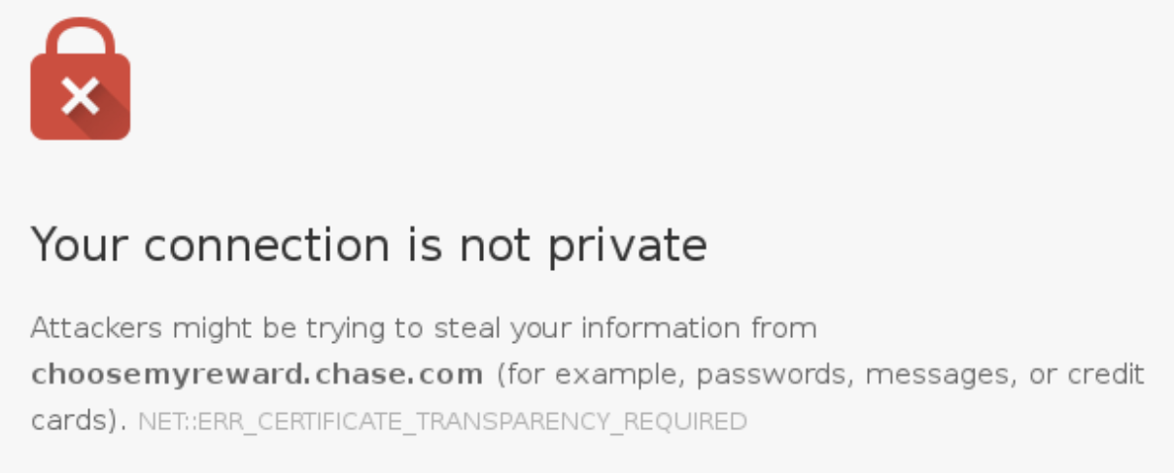
CT requirements
April 30, 2018: CT required by chrome
Required for all certificates with a path to a trusted root CA
(not required for an installed root CA)
Otherwise: HTTPS errors
Cert for crypto.stanford.edu
published on five logs:
  cloudflare_nimbus2018
  google_argon2018, google_aviator
  google_pilot, google_rocketeer
Notes:
https://transparencyreport.google.com/https/certificates
https://certificate.transparency.dev/ ➔ 8 billion certificates logged since 2013.

Slide 35
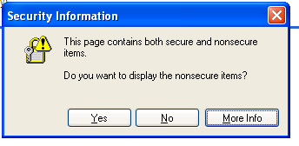
3. Mixed Content: HTTP and HTTPS
Page loads over HTTPS, but contains content over HTTP
(e.g. <script src=“http://.../script.js> )
  ⇒ Active network attacker can hijack session
by modifying script en-route to browser
never write this
IE7:
Old Chrome:
Mostly ignored by users …

Slide 36

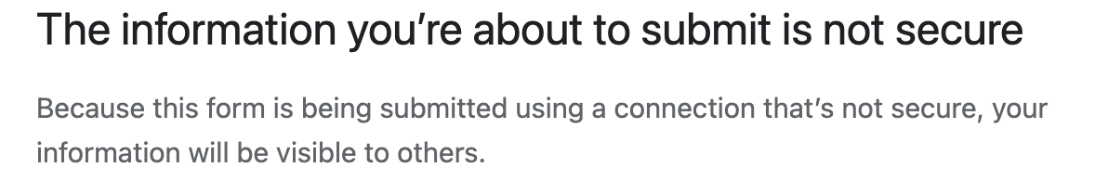

https://badssl.com (Chrome 124, 2024)
Mixed script: <script src="http://mixed-script.badssl.com/nonsecure.js"></script>
(no visible warning)
Mixed form: <form action="http://http.badssl.com/resources/submit.html">
script is not loaded! developer tools show an error.
Warning if user tries to submit data

Slide 37
4. Peeking through TLS: traffic analysis
Network traffic reveals length of HTTPS packets
  TLS supports up to 256 bytes of padding
Some sites interact frequently with the web server
  These interactions expose specific internal state of the page
BAM!
Chen, Wang, Wang, Zhang, 2010 (tax web site)
IOactive, 2012 (Google maps)
Notes:
https://ioactive.com/ssl-traffic-analysis-on-google-maps/

Slide 38
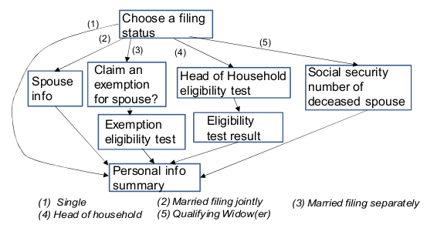
Peeking through TLS: an example [CWWZ’10]
Vulnerabilities in an online tax application
No easy fix. Can also be used to ID Tor traffic

Slide 39
THE END

